Slide 2
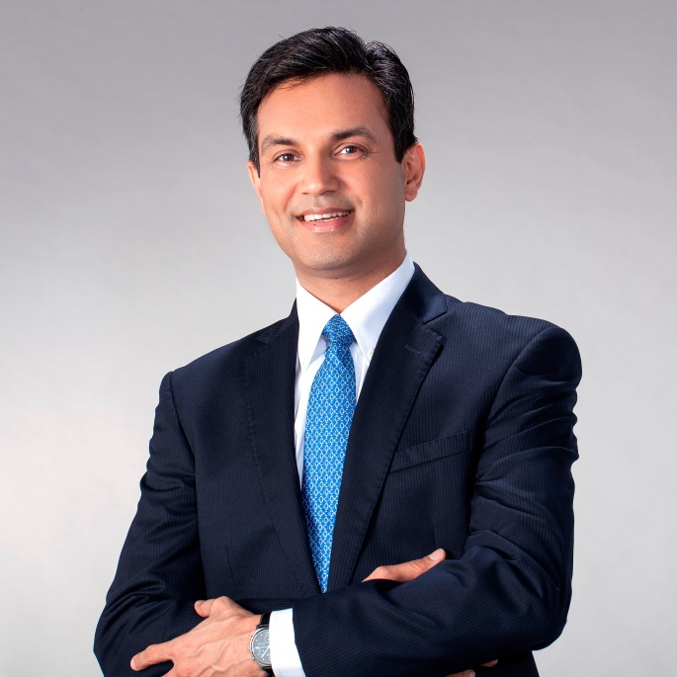
Ranga Rao Karanam
Founder, in28minutes

Slide 6






Platinum Partner
Gold Partner
Silver Partner

Slide 10
ANANT MAHESHWARI
President, Microsoft India

Slide 14
Platinum Partner
Gold Partner
Silver Partner

Slide 16
Presentation title

